Slide 1

Galaxy Project
FORTH, 24 January 2019
Alexandros Kanterakis
kantale@ics.forth.gr
Vangelis Kritsotakis
vkrits@ics.forth.gr
Προηγμένες Ερευνητικές Δραστηριότητες στη Βιοϊατρική Τεχνολογία & Αγροδιατροφή - ΒΙΤΑΔ (MIS 5002469)

Slide 2



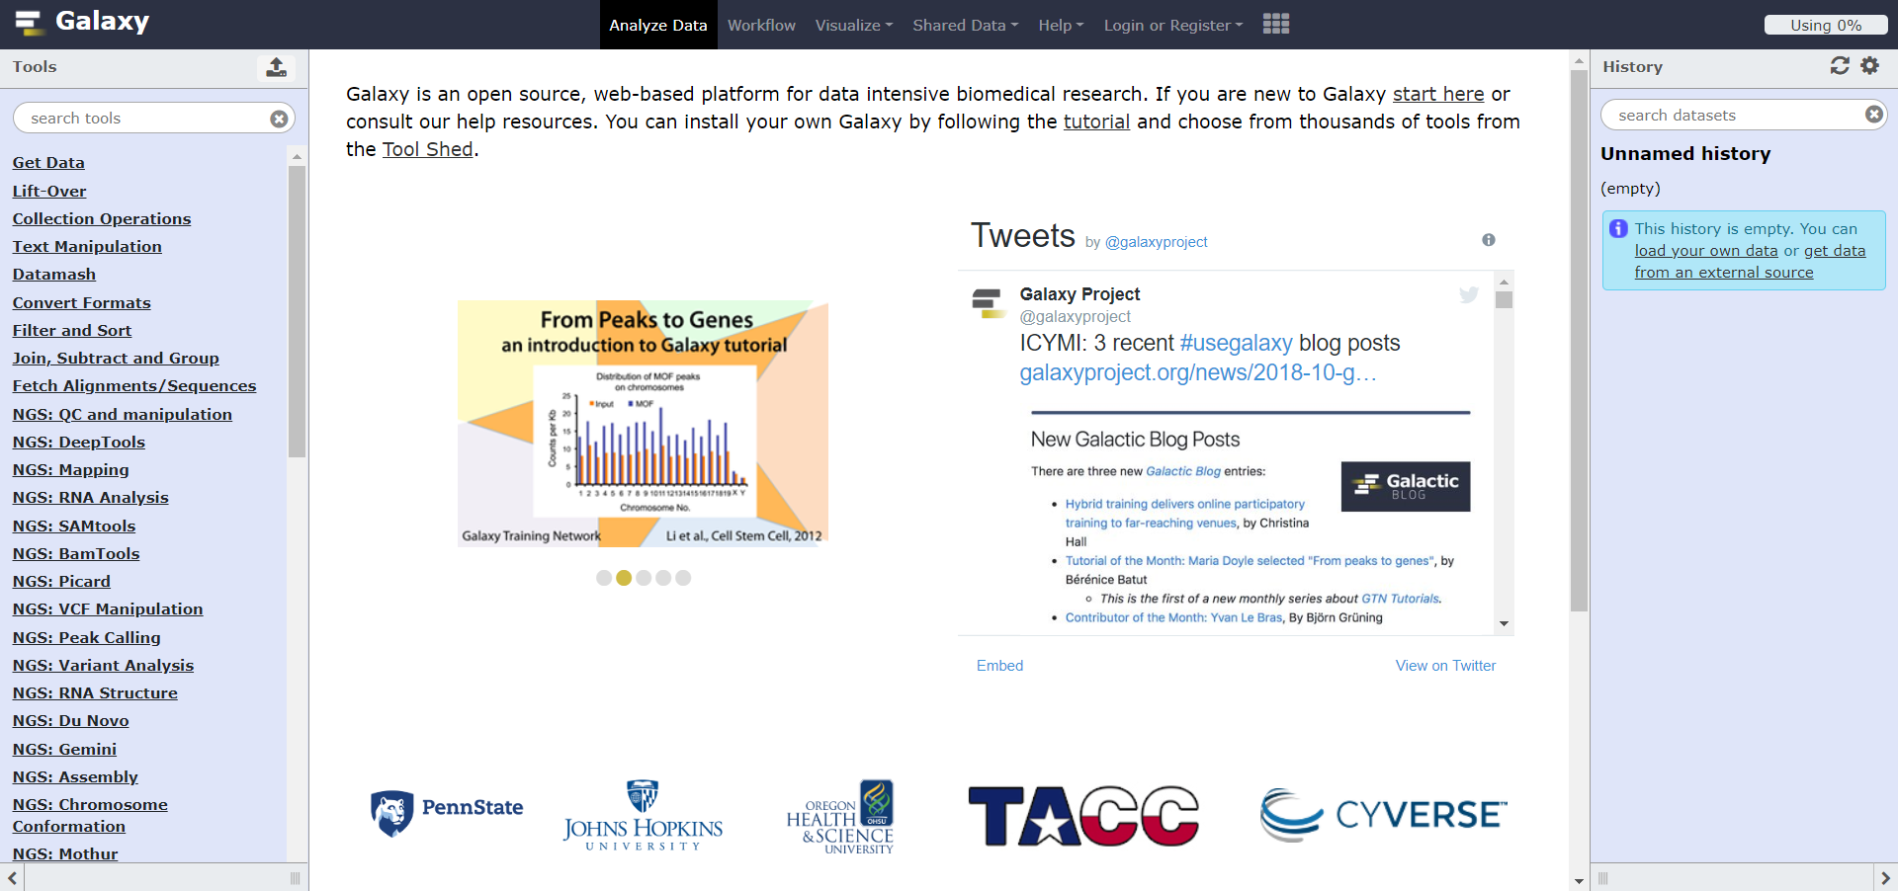


The Galaxy Software Framework
What is it?
An open-source web based application (Academic Free License) applicable for performing; computational analyses;
Enables researchers without informatics expertise to perform computational analyses;
More than 6,500 citations;
More than 125 public Galaxy servers;
How does it work?
Users interact with Galaxy through the web by uploading and analyzing data
Galaxy interacts with an underlying computational infrastructure without exposing it to the end user

Slide 3
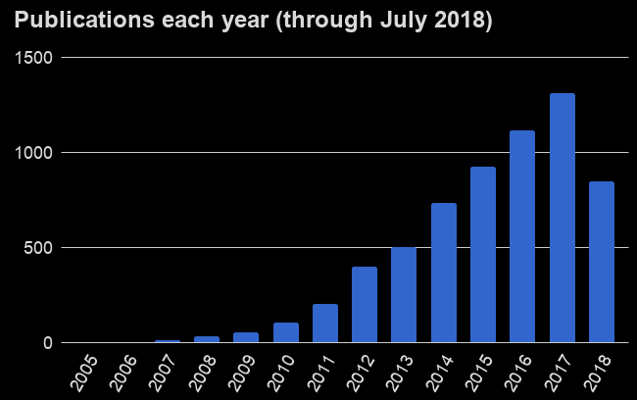
A Few Information
Who can contribute in development? Anyone (196 contributors so far)
Who maintains the platform? John Hopkins University
Who funds it? National Institute of Health (Grant 2U41HG006620)
When did it start? 2007
What is the primary language? Python 2 (experimental in 3)
Who uses it? Referred by 181 papers published in Nature
Additional user statistics: https://galaxyproject.org/galaxy-project/statistics/
Notes:
American private research university in Baltimore

Slide 4
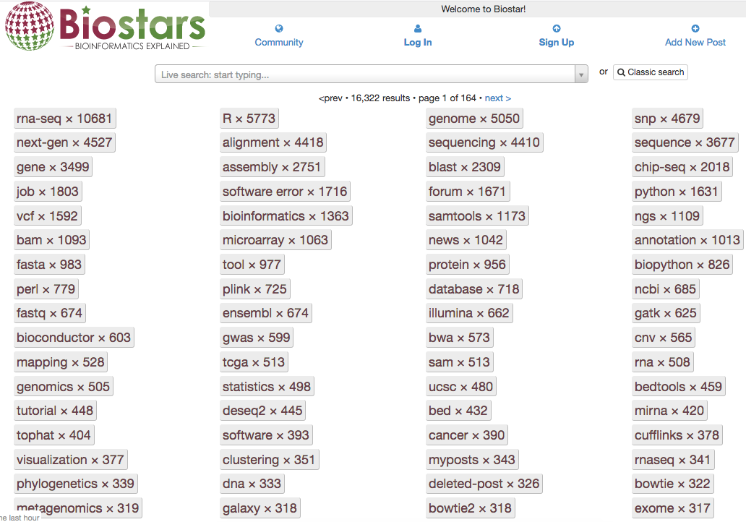
Popularity in BioStars
Notes:
This site's focus is bioinformatics, computational genomics and biological data analysis Stackoverflow of bioinformaticians

Slide 5
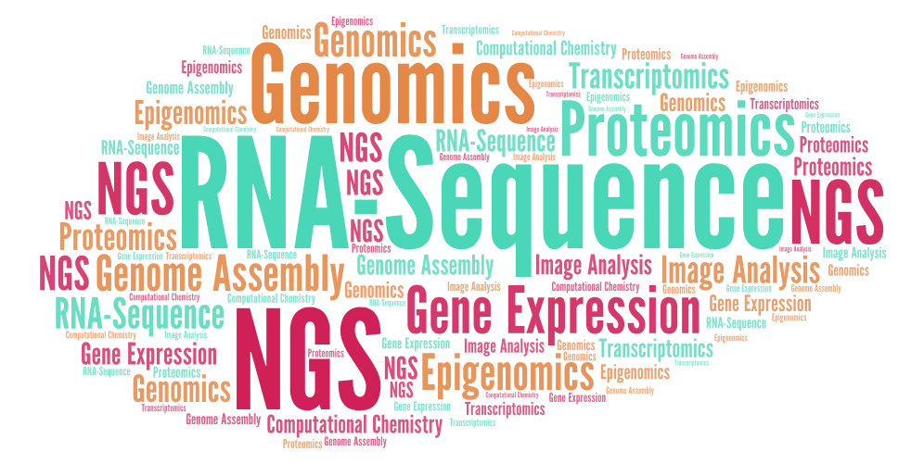
Use Case Studies
RNA-Sequence
Next Generation Sequencing (NGS)
Genomics
Gene Expression
Genome Assembly
Proteomics
Epigenomics
Transcriptomics
Image Analysis
Computational Chemistry

Slide 6
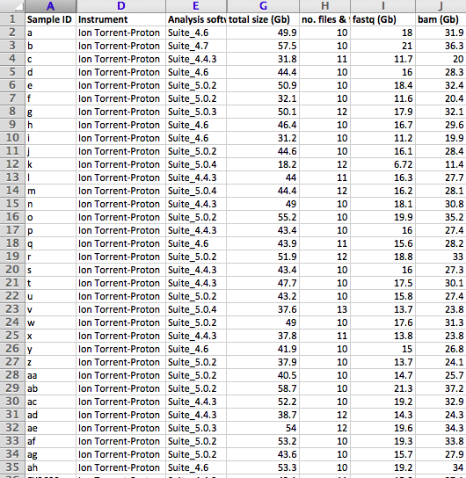
Real Life Dataset ...
Notes:
Management of a lot of data

Slide 7
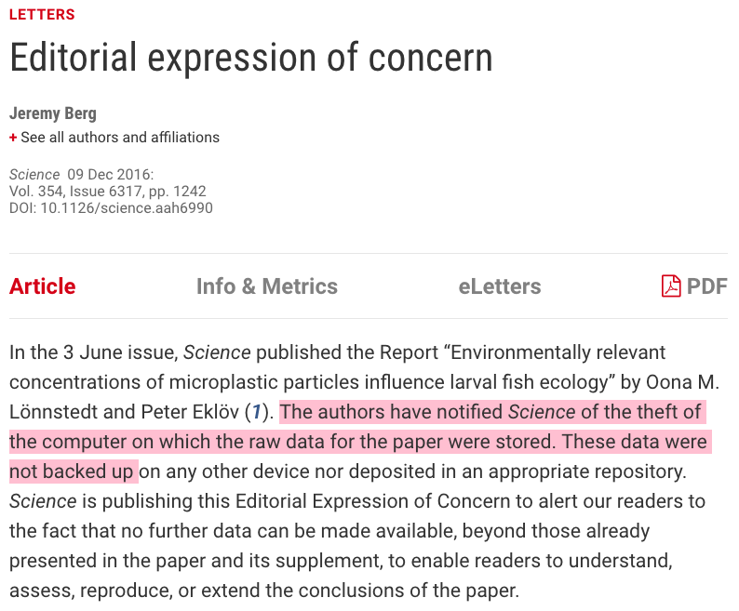

Notes:
Cloud storage benefits

Slide 8
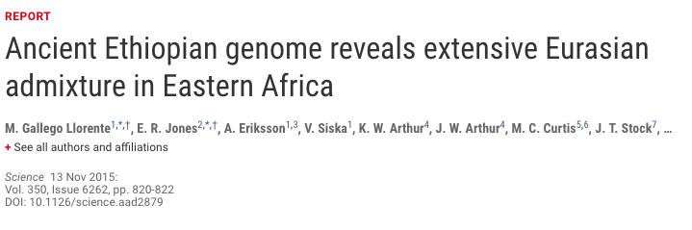
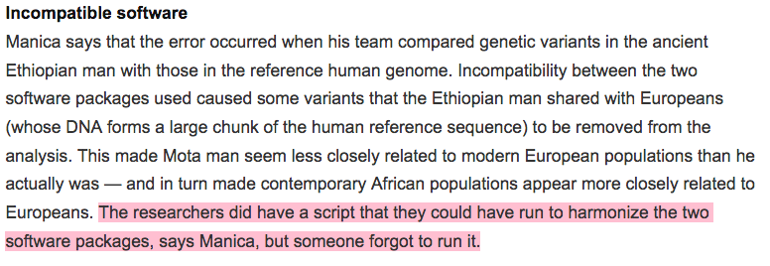
Notes:
If any workflow was made public available, someone would have tracked that issue and had report it along with the solution

Slide 9
Why Galaxy?
Accessibility No programming experience is required by users in order to run complex tools, workflows or visualize data
Reproducibility A computational analysis can easily be repeated by any user
Transparency Work done (workflows, visualizations) can easily be shared or published
Provenance. Which tools generated this file? With what parameters? When? Who?

Slide 10
High Performance Computing
Jobs are executed either:
On your local system (by default), or;
On a computational cluster
Supported Distributed Resource Managers:
TORQUE Resource Manager;
PBS Professional;
Open Grid Engine;
Univa Grid Engine (previously known as Sun Grid Engine and Oracle Grid Engine);
Platform LSF;
HTCondor;
Slurm;
Galaxy Pulsar (formerly LWR);

Slide 11
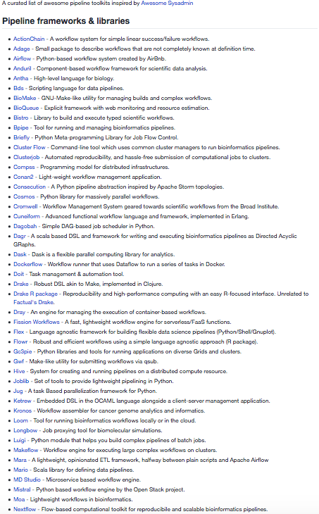
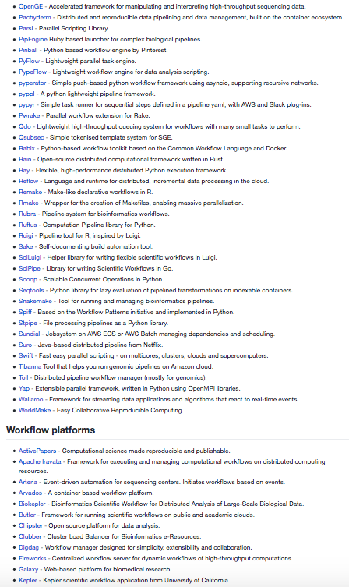
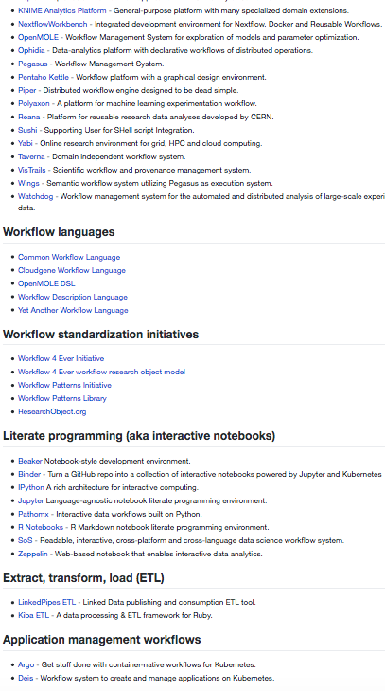
Is Galaxy the only option?
https://github.com/pditommaso/awesome-pipeline
Notes:
Plenty of options available, however so far Galaxy is the most popular one since it provides the pack of everything that’s needed.
The majority of the available tools are either too specific in some region, mich lack of UI or might be comercial.
Taverna, Knime, Next-flow

Slide 12
The Public Galaxy Service (https://usegalaxy.org/)
This is an installation of the Galaxy software combined with many common tools and data;
It is free of charge and can be used by anyone;
Provides substantial CPU and disk space (250 GB) and is capable of analysing large datasets;
We will use it to run a few examples later on;
Notes:
To continue: - 3 Examples:
Alignment & Variant Calling
Variant Annotation Variant Filtering

Slide 13
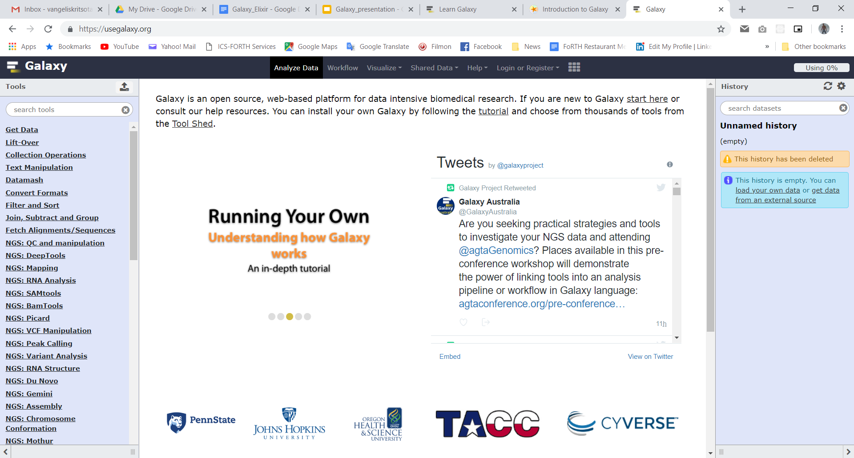
Main Galaxy User Interface
Main Menu
Tools
Main Content
History

Slide 14

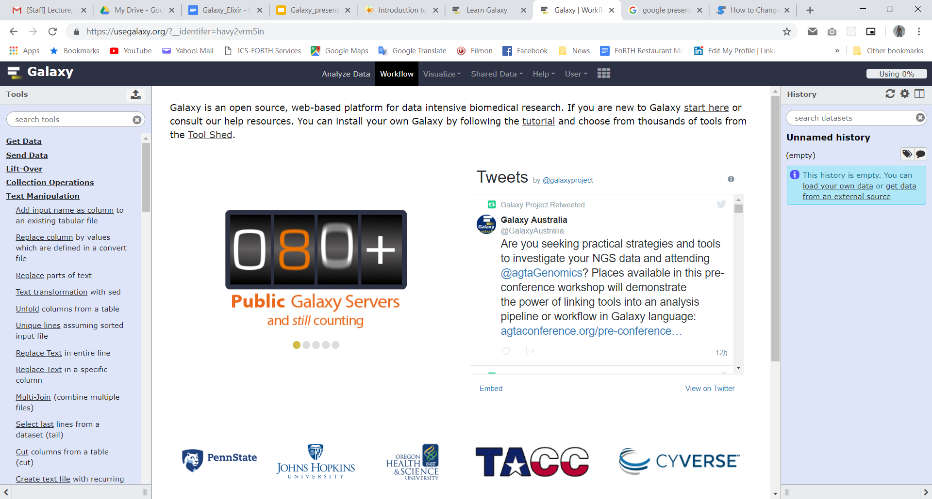
Main Galaxy User Interface
Main Menu
Analyze Data - Navigate back to homepage
Workflow - Access existing workflows or create new ones
Visualization - Access your saved visualisations
Shared data - Access data libraries, histories, workflows, visualizations and pages shared with you
Help - Helpful links
User - Your preferences and saved histories, datasets, and pages
Tools
Main Content
History

Slide 15
Main Galaxy User Interface
Main Menu
Each tool is a text file describing:
input datasets,
parameters,
commands, and
outputs
Free tool store: Galaxy Tool Shed
Thousands of tools already available
New versions can be installed without removing old ones to ensure reproducibility
Tools
Tools
Main Content
History

Slide 16
Main Galaxy User Interface
Main Menu
Ανy dataset produced by tools you run or operations performed on your data are located here;
For each dataset, the history tracks:
Name, format, size, creation time, datatype-specific metadata
Tool ID and version, inputs, parameters
Standard output (stdout) and error (stderr)
State (waiting, running, success, failed)
Hidden, deleted, purged options
Tools
History
Main Content
History

Slide 17
A typical NGS pipeline (1/3) Alignment & Variant Calling
FastQ Raw Sequencing Data
Alignment
BAM/SAM Files
Reference Genome (FASTA)
BAM/SAM Files
Variant Calling
List of Variants (VCF File)
Reference Genome (FASTA)

Slide 18
Let’s go!
Get your laptops and fire up:
https://usegalaxy.org/
https://github.com/kantale/galaxy_seminar_crete

Slide 19
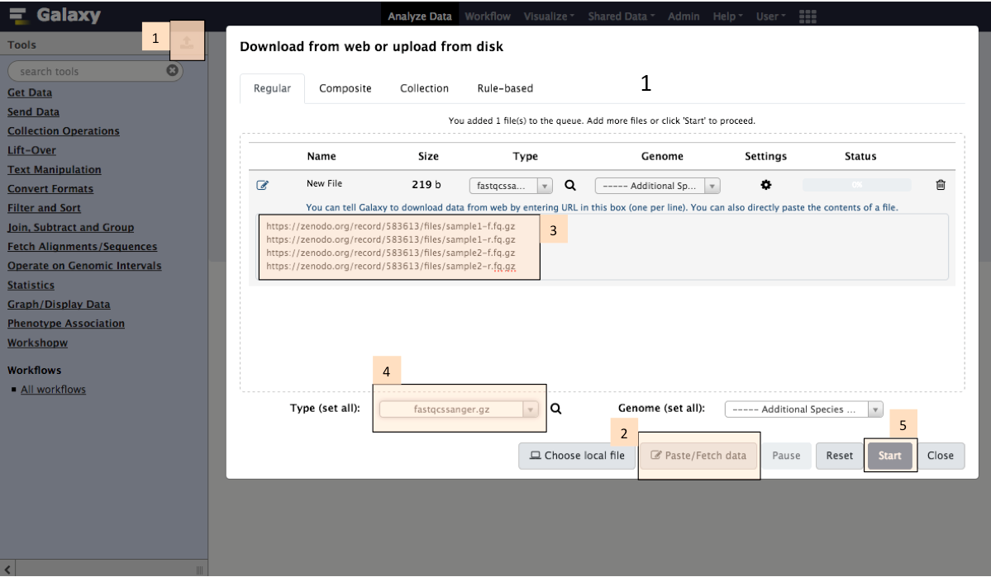
Upload FastQ files from URLs
Notes:
https://zenodo.org/record/583613/files/sample1-f.fq.gz https://zenodo.org/record/583613/files/sample1-r.fq.gz https://zenodo.org/record/583613/files/sample2-f.fq.gz https://zenodo.org/record/583613/files/sample2-r.fq.gz

Slide 20
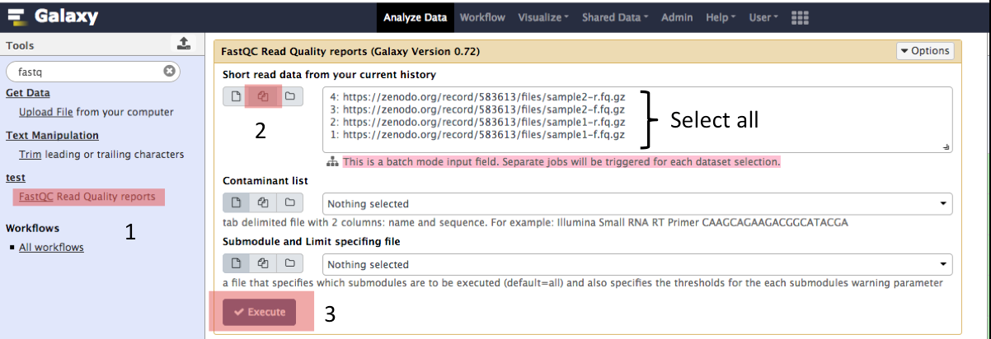
Run FastQC
P.S.: Separate jobs will be triggered for each dataset selection

Slide 21
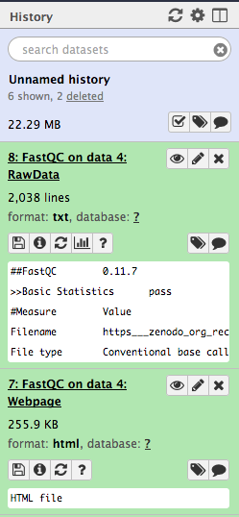
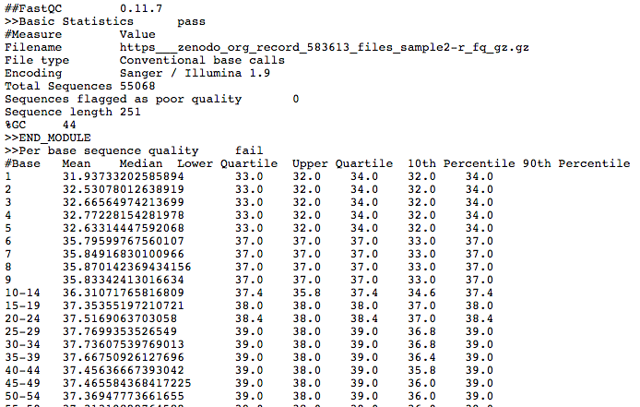
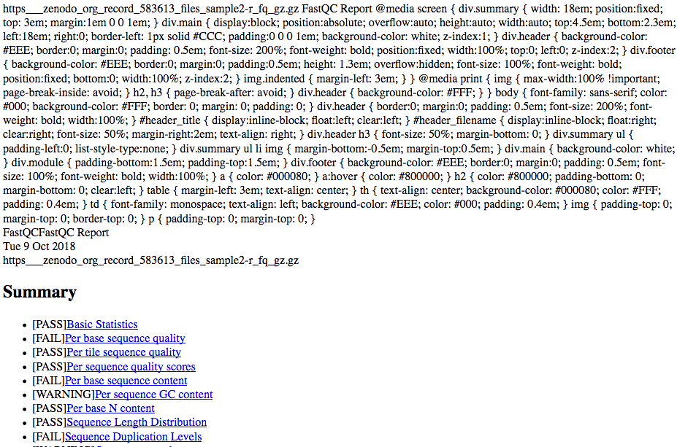
Results are shown on the history panel

Slide 22
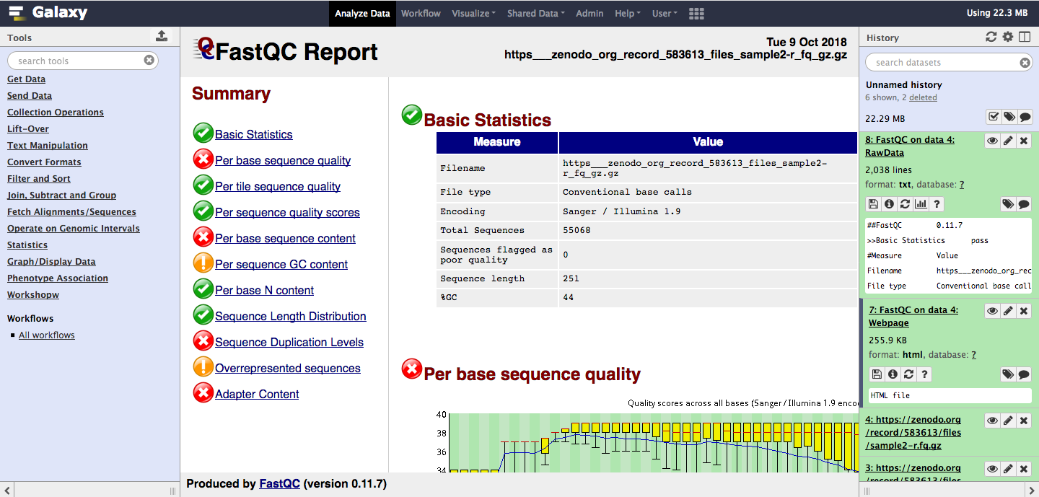
View HTML output of a tool within Galaxy

Slide 23
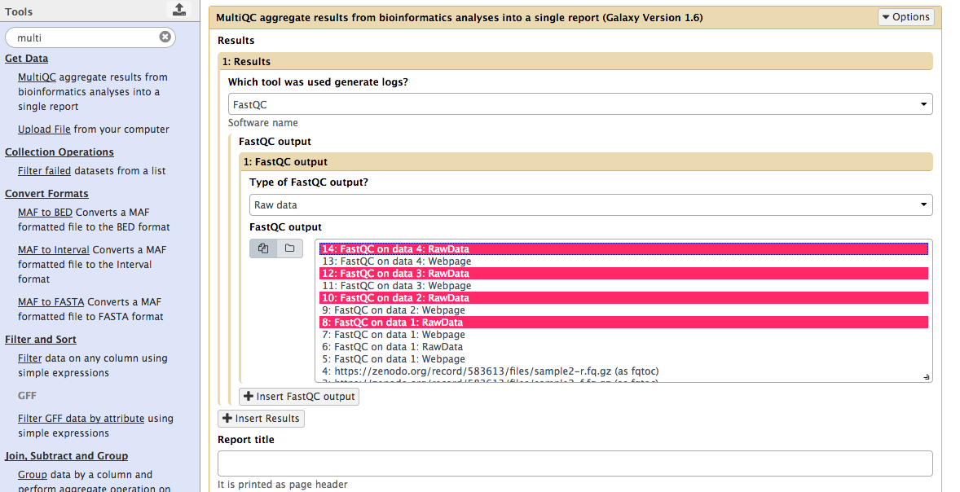
Run MultiQC

Slide 24
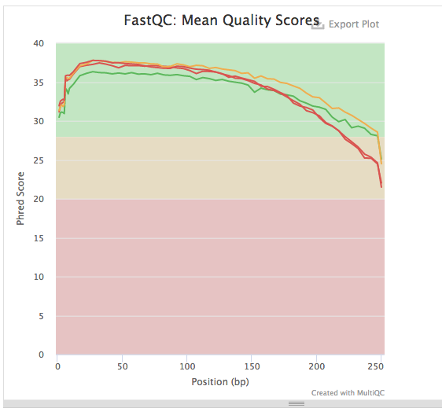
MultiQC results

Slide 25
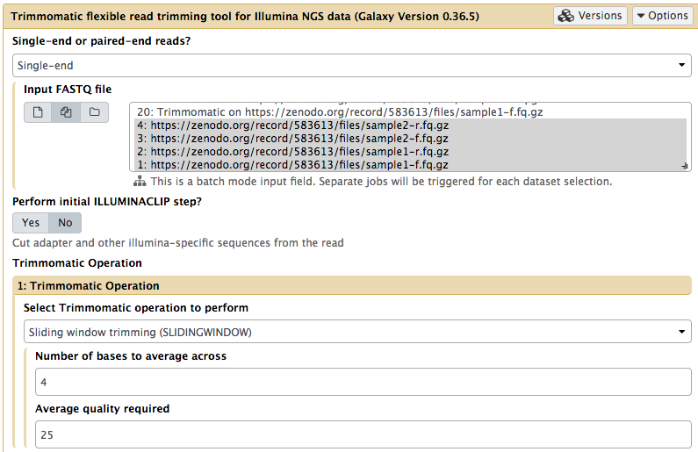
Trim fastq reads with Trimmomatic

Slide 26
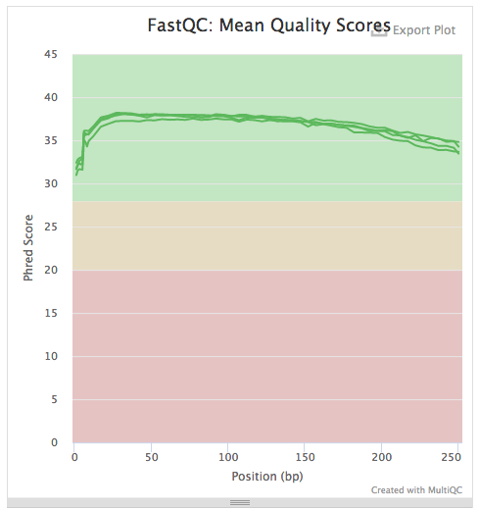
Run FastQC on trimmed reads + MultiQC

Slide 27
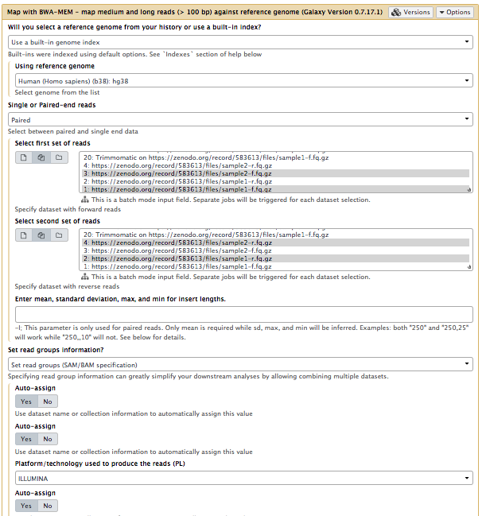
Alignment of Reads on Reference Genome
Alignment tool: BWA-MEM
This takes a long time!

Slide 28
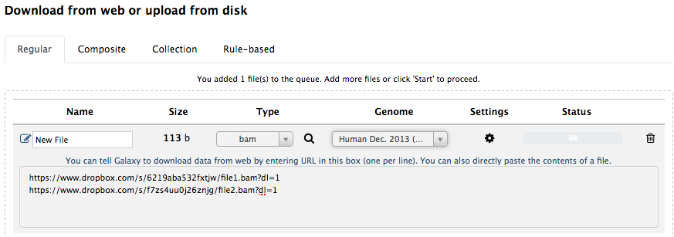
Load Alignment Results
https://www.dropbox.com/s/6219aba532fxtjw/file1.bam?dl=1
https://www.dropbox.com/s/f7zs4uu0j26znjg/file2.bam?dl=1

Slide 29
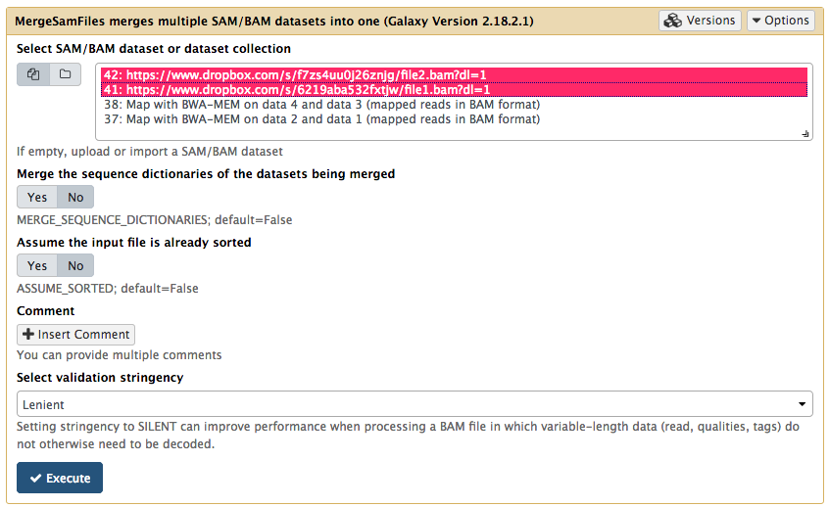
Merge SAM/BAM Files

Slide 30
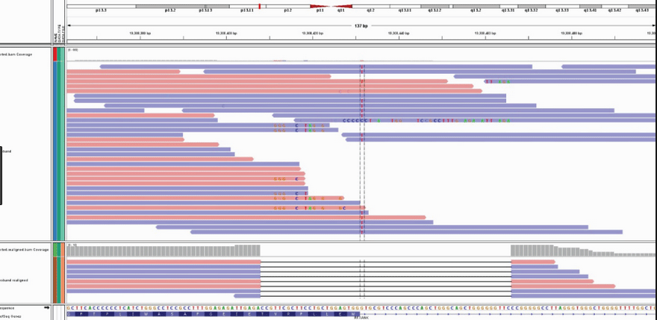
Quality Control and BAM Alignment
Use (Download) Integrative Genome Viewer (IGV)
Download BAM files from Galaxy
Load BAM files to IGV
An alternative solution is IGB: https://bioviz.org/

Slide 31
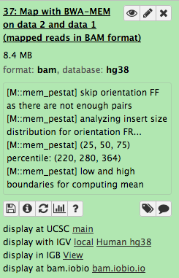
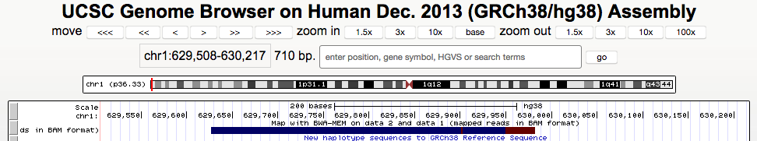
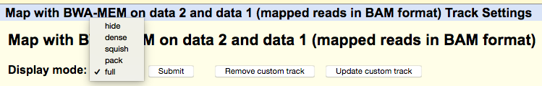
Inspect BAM File with UCSC Genome Browser
2
1
3

Slide 32
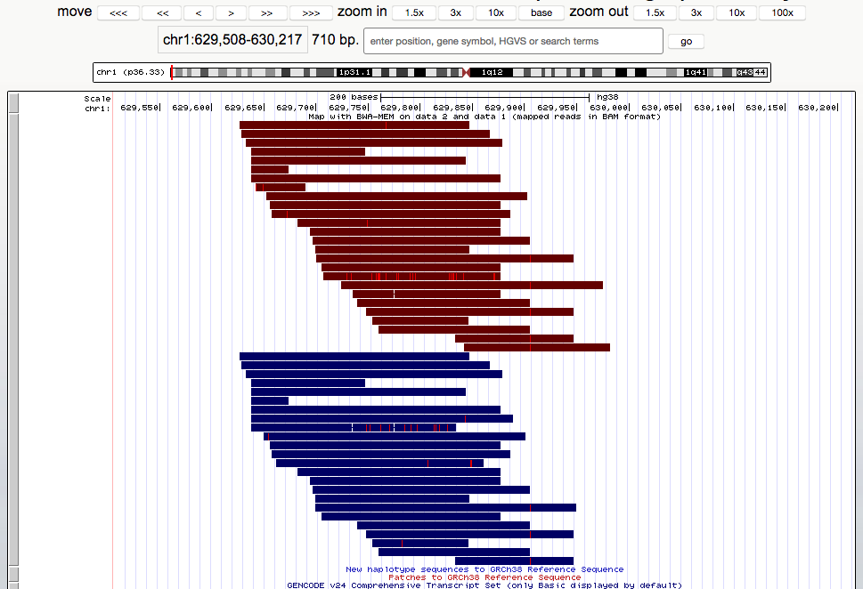
Visualization of Aligned Reads in UCSC

Slide 33
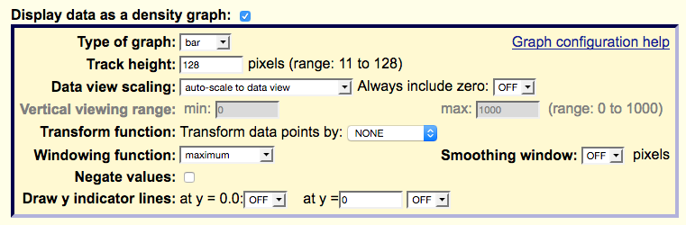
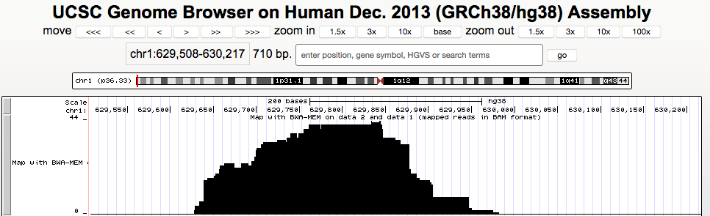
Alternative: Display data as a density map
1
2

Slide 34
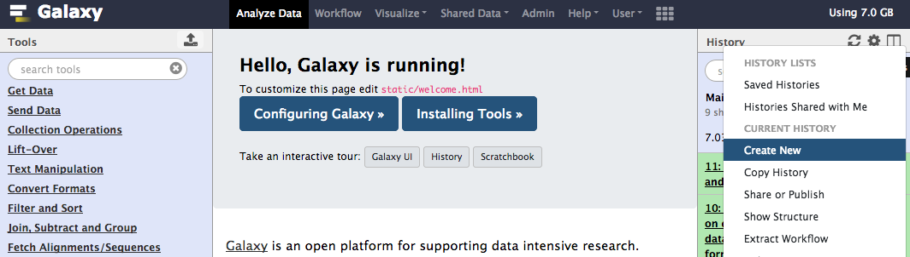
Create New History

Slide 35
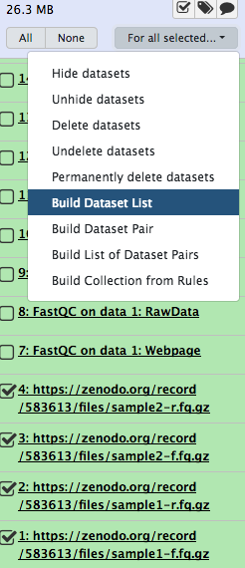
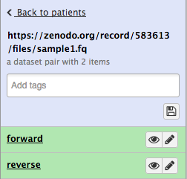
Group Datasets
Flat lists
FastQC on Flat Collection
MultiQC on output of FastQC
Dataset Pairs
For forward/reverse pair-end data

Slide 36
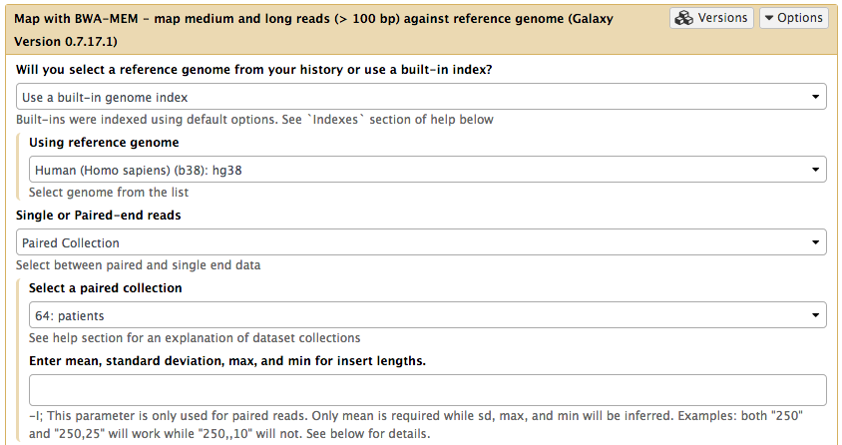
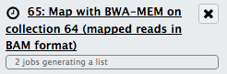
Map Paired Dataset
After execution you should see on history panel

Slide 37
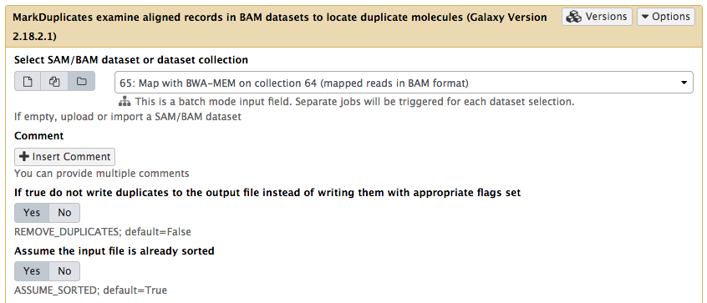
Mark Duplicates

Slide 38
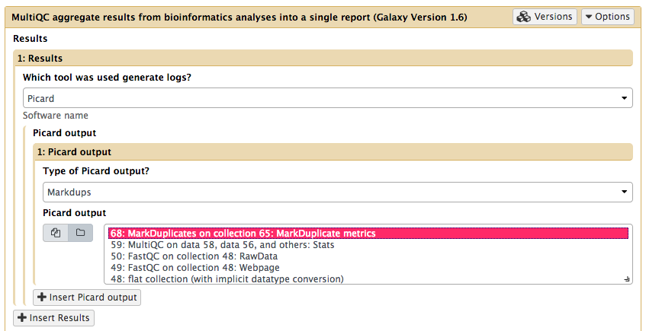
Visualize Marked Duplicates

Slide 39
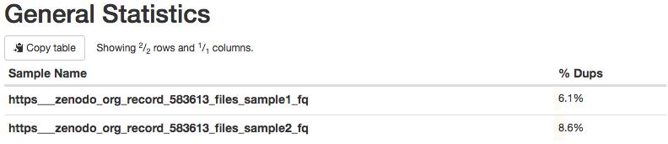
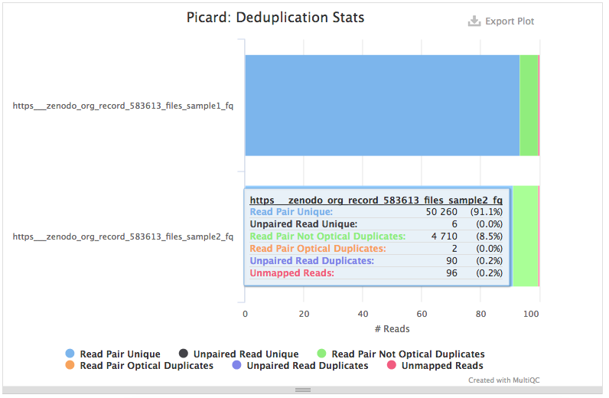
Visualize Marked Duplicates - Results

Slide 40
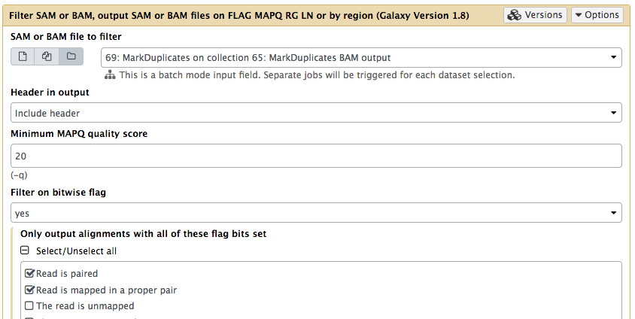
Filter Alignment (SAM/BAM) File

Slide 41
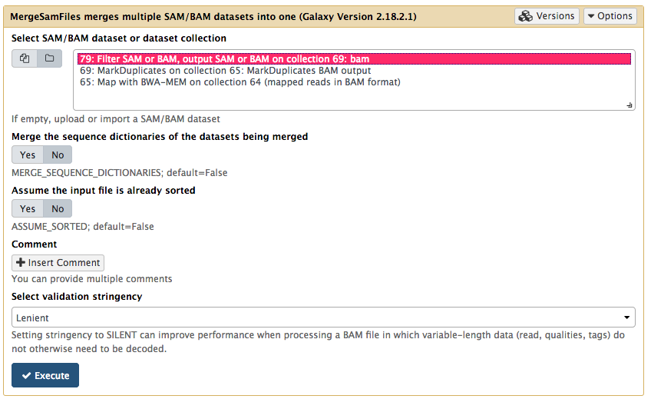
Merge SAM/BAM Files Together

Slide 42
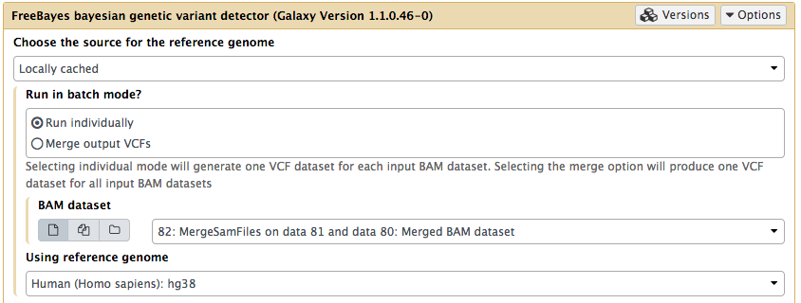
Variant Call with FreeBayes
Do not perform this step now

Slide 43
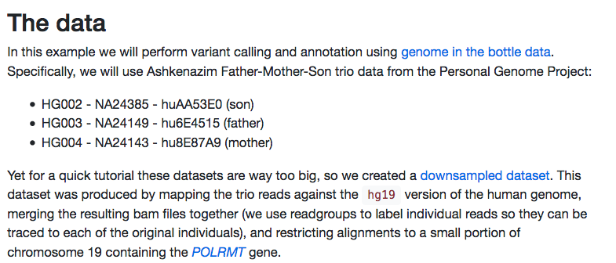
Variant Calling
More info: https://galaxyproject.github.io/training-material/topics/variant-analysis/tutorials/dip/tutorial.html

Slide 44
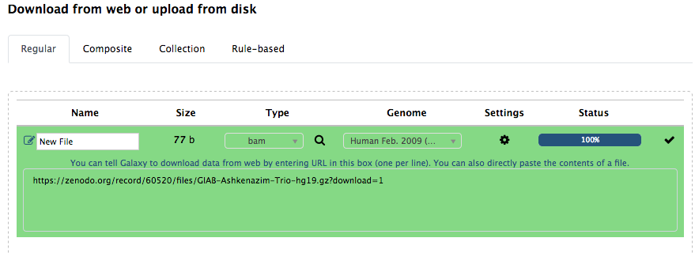
Upload BAM files
https://zenodo.org/record/60520/files/GIAB-Ashkenazim-Trio.txt?download=1
Make sure that Type=bam Genome=hg19

Slide 45
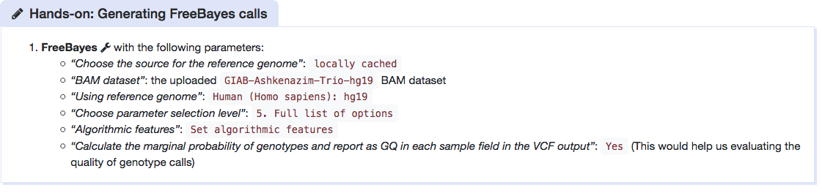
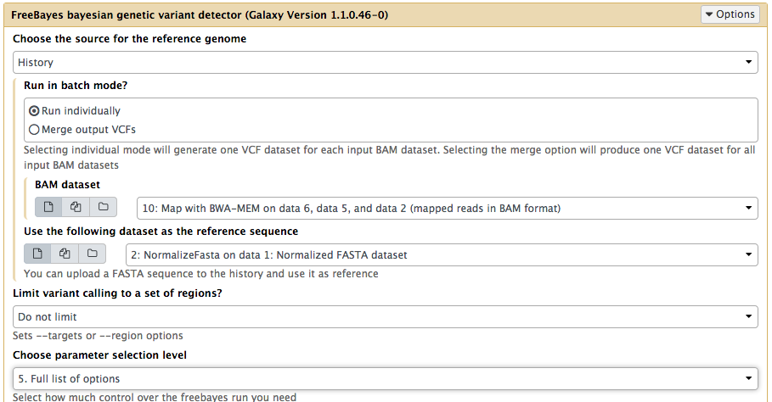
Variant Calling
https://galaxyproject.github.io/training-material/topics/variant-analysis/tutorials/dip/tutorial.html
Use FreeBayes
Run FreeBayes
Produces a VCF File
Takes a long time!
Notes:
https://galaxyproject.github.io/training-material/topics/variant-analysis/tutorials/dip/tutorial.html

Slide 46
Load VCF file
https://www.dropbox.com/s/412m4z57ezr9oqd/freebayes_result.vcf?dl=1
Set:
Filetype: VCF
Genome: hg19

Slide 47
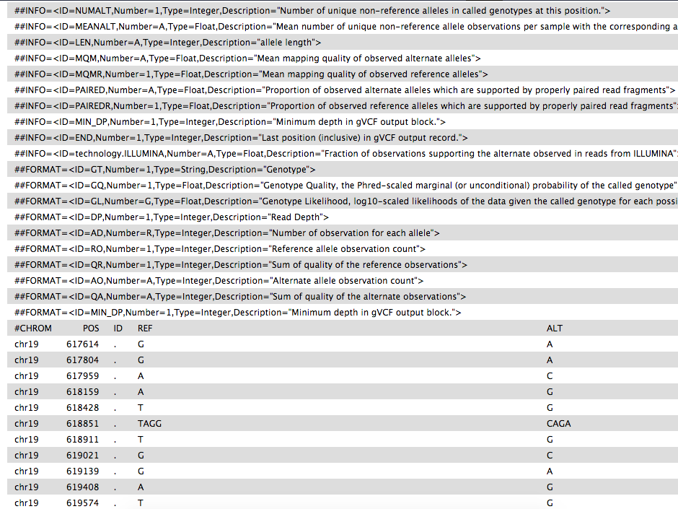
VCF Generated File

Slide 48

Post-process VCF File
Before we proceed we need to post-process this dataset by breaking compound variants into multiple independent variants.
VcfAllelicPrimitives tool with:
Select VCF dataset: the VCF output of FreeBayes tool
Maintain site and allele-level annotations when decomposing: Yes
Maintain genotype-level annotations when decomposing: Yes

Slide 49
A typical NGS pipeline (2/3) Variant Annotation
Annotation External DataBases
(i.e effect, function, clinical significance, frequencies, …)
List of Variants (VCF File)
Annotated VCF File

Slide 50



Variant Annotation (configure databases)
1
3
Use the snpEff tool.
Run SnpEff databases Free text search on the list of available annotations (big volume).
Run SnpEff Download Copy & paste the name of the database of your interest, from the results to the “SnpEff Download” tool, to download the database
2
Continues on the Next Slide
Notes:
First run: snpEff databases. Free text Search on the list of available annotations (1000s).
Second: Copy paste from the results the name of the database of your interest and run snpEff download. This downloads the database
(cont’d next slide)

Slide 51

Variant Annotation
Run snpEff (~10mins):

Slide 52

SnpEff Annotation Results

Slide 53
SnpEff results
HTML Report:
https://www.dropbox.com/s/oowvo7n4gob470w/SnpEff_html.html?dl=1
Type: Automatically select → Change Attributes → Convert to HTML
VCF File:
https://www.dropbox.com/s/yi4zb0r2mx639hl/SnpEff_vcf.vcf?dl=1

Slide 54
A typical NGS pipeline (3/3) Variant Filtering
Annotated VCF File
Filtering Region, Function
List of Interesting Variants (Small Text File)

Slide 55

Variant Filtering
Load sample information
https://zenodo.org/record/60520/files/GIAB-Ashkenazim-Trio.txt?download=1
Type: tabular

Slide 56



GEMINI: load and db_info
Creates an sqlite database Annotates the VCF file and Inserts
it into an SqlLite
Sample information file in PED+ vcf: Trio information
Choose a gemini annotation database: The most recent
1
2. Inspects the SqlLite contents and outputs the full list fields
2
3
Notes:
Annotates the VCF file and Inserts it into an SqlLite
Sample information file in PED+ vcf: The TRIO file
Choose a gemini annotation database: The most recent
Inspects the SqlLite contents and outputs the full list fields

Slide 57


Unfortunately… GEMINI is problematic (for the time being)
So.. let’s go to our cluster: http://139.91.75.205
(This Galaxy installation is temporary. We give directions on how to install your own and the end of this presentation)
https://biostar.usegalaxy.org/p/29608/
Upload Trio + SnpEff VCF

Slide 58


GEMINI: Query - Simple Case
Selecting “novel” variants that are not annotated in dbSNP database
Filtering is applied through SQL Quering
This example outputs a single value
Selecting the SqlLite File
Defining the SQL Query

Slide 59


GEMINI: Query - More Advanced Case
Variant Filtering: Find variants within the POLRMT gene
Selecting the same SqlLite File
Defining a more complex SQL Query
Outputs a three column table with results

Slide 60
Querying genotypes (1/3)
At how many sites does child have a non-reference allele?
The query to be issued to the database:
SELECT * from variants
Restrictions to apply to genotype values:
gt_types.HG002_NA24385_son <> HOM_REF

Slide 61
Querying genotypes (2/3)
At how many sites both father and son have non reference alleles?
The query to be issued to the database:
SELECT * from variants
Restrictions to apply to genotype values:
(gt_types.HG002_NA24385_son <> HOM_REF AND gt_types.HG003_NA24149_father <> HOM_REF)

Slide 62
Querying genotypes (3/3)
List genotypes for father and son where they have non-reference alleles.
The query to be issued to the database:
SELECT gts.HG002_NA24385_son, gts.HG003_NA24149_father from variants
Restrictions to apply to genotype values:
(gt_types.HG002_NA24385_son <> HOM_REF AND gt_types.HG003_NA24149_father <> HOM_REF)

Slide 63
A (more complex) Variant Calling pipeline with mpileup and GATK
https://docs.google.com/document/pub?id=1CuKkKylVDb03tnN7RSWl5EUzleetn0ctjmvaidPKLxM

Slide 64
Workflows
Create a new history
Do a simple analysis: FastQC + MultiQC
Create Workflow
Re-run!
Share workflow
List of published workflows:
https://usegalaxy.org/workflows/list_published

Slide 65

Combine Trimmomatic + MultiQC

Slide 66

Create a workflow that uses FastQC

Slide 67

Executing..

Slide 68

View (and import) data and workflows shared by others!

Slide 69
The Galaxy Tool Shed
https://toolshed.g2.bx.psu.edu/
Search for tools and worfklows
Admin → Install New Tools → Search for workflows

Slide 70
Installing Galaxy on a Server
Following instructions from: https://galaxyproject.org/admin/get-galaxy/

Slide 71
Setup on Amazon Cloud
# Update the current instance
>> sudo apt-get update
# ONLY WHEN DEPLOYED ON AMAZON: locale on Linux and UNIX systems (set of parameters that defines the user's language, region)
>> export LC_ALL="en_US.UTF-8"
# Installing Python 2
sudo apt-get install -y python2.7
sudo ln -s /usr/bin/python2.7 /usr/bin/python
# Installing Gallaxy by cloning from github
>> git clone -b release_18.05
https://github.com/galaxyproject/galaxy.git

Slide 72

Setup on Amazon Cloud
>> cd galaxy
# Make it accessible from other machines
# Edit the sample file with any editor (i.e vim)
>>vim config/galaxy.yml.sample
# Find the property uwsgi/http
# Change the value http: 127.0.0.1:8080 to http: 0.0.0.0:8080

Slide 73
Setup on Amazon Cloud
# Renaming the sample file such that it is readable from Galaxy
>> mv config/galaxy.yml.sample config/galaxy.yml
# Starting Galaxy Instance
>> sh run.sh --daemon
# Stopping Galaxy Instance
>> sh run.sh --stop-daemon

Slide 74
Checking the web UI
Find the ip of your remote computer (i.e. 18.195.120.89)
Go to: http://18.195.120.89:8080/
Or if this is a local installation
Go to: http://localhost:8080/
Note: If you are using ad-blocker, you may have to disable it
Notes:
Stop with CTRL-C
sh run.sh to restart
sh run.sh --daemon
sh run.sh --stop-daemon

Slide 75

You should be able to see something like this

Slide 76

Some More Configuration
Register through UI
Create Admin account
Edit again: config/galaxy.yml
Change: #admin_users: null → admin_users: kantale@ics.forth.gr
Tool repository for Galaxy (over 1000 tools) https://toolshed.g2.bx.psu.edu/

Slide 77
Install GEMINI
https://gemini.readthedocs.io/en/latest/
# Create a directory for the Gemini tool (anywhere)
>> mkdir gemini_tools/
# Create a directory for Gemini’s data(anywhere)
>> mkdir gemini_data/
# Downloading Python script to run
>> wget https://github.com/arq5x/gemini/raw/master/gemini/scripts/gemini_install.py
# Running the Python script to install anything about Gemini
>> python gemini_install.py gemini_tools/ gemini_data/ --gemini-version 0.18.1
# Finally add gemini_tools/bin to $PATH

Slide 78
Install a New Tool into Galaxy
Three ways of installing tools
Tool Shed - A free service for tool developers and Galaxy admins to host and share Galaxy utilities
Manually - If a tool is not currently in the Tool Shed, it can be wrapped and added to Galaxy and later shared in the Tool Shed with the rest of the world
Automated installation through the Tool Shed - A convenient way of installing a large number of tools is to use a set of scripts, which are available as an Ansible playbook
Galaxy is by default connected to the Main Tool Shed. However it is possible to be connected to other custom Tool Sheds
Notes:
Ansible is a tool that helps automating a procedure that has to be repeated multiple times.

Slide 79

Installing fastQC from Tool Shed
Admin → Install new tools → Galaxy Main Tool Shed → Browse valid repositories → Search for “fastqc”
Notes:
Devteam is the official Galaxy team

Slide 80
Results are shown on the history panel

Slide 81
Results are shown on the history panel
Why does it look like this?
Isn’t that supposed to be html?
The output of this tool should be whitelisted!

Slide 82

How to whitelist the output of a tool
Admin → Manage whitelist
Select the FastQC checkbox
Press “Submit new whitelist”

Slide 83


Installing a Genome Reference in Galaxy
Follow instructions from: https://galaxyproject.org/learn/custom-genomes/
Step 1: Download http://hgdownload.soe.ucsc.edu/goldenPath/hg38/bigZips/hg38.fa.gz
Step 2: Normalize fasta with NormalizeFasta (from Picard)
1
2
Notes:
For hg19 use ftp://ftp.1000genomes.ebi.ac.uk/vol1/ftp/technical/reference/human_g1k_v37.fasta.gz or http://hgdownload.soe.ucsc.edu/goldenPath/hg19/bigZips/hg19.2bit

Slide 84

Installing a Custom Tool in a local Galaxy
Suppose we have this tool:
Location: tools/mytools/

Slide 85

Create an XML wrapper
Location: tools/mytools

Slide 86

Yet another wrapper (for tool section)
Location: config/

Slide 87
Add tool configuration XML in galaxy.yml
tool_config_file = config/tool_conf.xml.main,config/my_tool_conf.xml

Slide 88

Connecting Galaxy with a Cluster
https://docs.galaxyproject.org/en/latest/admin/cluster.html

Slide 89
Thank You

